Slide 1



INTERIM SEMESTER 2024-25
PROJECT EXHIBITION 1
DSN2098
PROJECT TITLE:
Precision Agriculture Using Machine Learning
A Machine Learning Approach For Sustainable Farming and Prosperous Harvests

Slide 2

Group no: 160
1
Ishan Khare - 23BCE10317
Project Supervisor:
Dr. Vijendra Singh Bramhe
2
Amogh Agarwal - 23BCE10220
Reviewer I:
Dr. Jitendra P.S. Mathur
Reviewer II:
Dr.G.R. Hemalakshmi
3
Shreedhar Daingade- 23BCE10321
4
Shubrat Mishra - 23BCE10340
5
AAyush Singh-23BCE10279

Slide 3


INTRODUCTION
Agriculture supports 42.86% (According to the Economic Survey 2023-24) of India's population, with 54.6% engaged in it and 70% of rural households relying on it for livelihood. However, challenges like poor crop choices, outdated methods, and climate impacts hinder productivity and farmer stability. A proposed Machine Learning-based crop recommendation system will analyze soil, climate, and historical data to suggest optimal crops, promoting sustainable farming and improving incomes.

Slide 4
EXISITING WORK
Ensemble Learning for Robustness:
Ensemble methods, such as Random Forest and Gradient Boosting, have proven effective in improving the accuracy and stability of soil classification and crop recommendation models. By combining multiple base models, these techniques can mitigate the impact of noise and overfitting.
Feature Engineering for Improved Performance:
Effective feature engineering, involving the creation of new features or transformation of existing ones, can significantly enhance the performance of ML models. For example, combining soil properties with climatic factors can lead to more accurate crop recommendations.
Deep Learning for Complex Patterns:
Deep learning models, like Convolutional Neural Networks (CNNs) and Recurrent Neural Networks (RNNs), can capture complex patterns and relationships within large and diverse datasets. These techniques have the potential to further improve the accuracy and precision of soil classification and crop recommendation systems

Slide 5


LIMITATIONS
Limited Dataset Diversity:
Existing methods often rely on specific datasets, such as soil analysis or agricultural data, which may not account for regional variations or real-time environmental changes, limiting their generalizability.
Focus on Accuracy Over Practicality :
While high accuracy rates (up to 99.91%) are reported, practical aspects like ease of implementation, cost-effectiveness, and farmer accessibility are not adequately addressed.
Insufficient Integration of Dynamic Factors:
Key factors such as changing weather patterns, market demands, and pest/disease outbreaks are not consistently integrated, reducing the adaptability of these systems to real-world challenges.

Slide 6
PROPOSED WORK
The proposed system assists farmers in making informed decisions by recommending suitable crops based on soil nutrients, temperature, and rainfall and forecasting yields using factors like rainfall, pesticide use, and temperature.
By leveraging machine learning, the system aims to enhance productivity, promote sustainable farming practices, and improve farmer incomes.
METHODOLOGY
The methodology involves two processes: Crop Prediction and Yield Prediction. The Random Forest Classifier recommends crops based on soil and environmental factors, achieving 99.32% accuracy after preprocessing, training, and testing.
The Decision Tree Regressor predicts crop yields using inputs like rainfall, temperature, pesticides, and crop type, achieving 96.95% accuracy.
Both models are saved for future use, and a user-friendly web app provides easy interaction through input forms and dashboards.

Slide 7

NOVELTY OF PROJECT
This project stands out due to its integration of soil, climate, and environmental data for precise crop recommendation and yield prediction. Unlike existing solutions that focus solely on either soil or weather parameters, this system adopts a holistic approach by:
Leveraging Machine Learning (ML) models for both crop and yield prediction.
Combining multiple factors like nitrogen, phosphorus, potassium levels, pH, temperature, and rainfall for precise recommendations.
Utilizing advanced preprocessing techniques to handle data inconsistencies and ensure accuracy.
Offering a user-friendly interface designed for farmers, making complex predictions accessible to non-technical users.
AN

Slide 8


Real-Time Usage of the Project
The system can be utilized in real-time scenarios for:
Crop Recommendation: Farmers input soil and environmental data to get immediate recommendations for suitable crops.
Yield Prediction: Predictions on crop yield help in planning resources like fertilizers, pesticides, and irrigation.
Agricultural Advisory: Government agencies and NGOs can provide tailored advice using this system.
Market Predictions: Traders and suppliers can forecast market demand and supply based on yield predictions.
Integration with IoT: Sensors in fields can feed real-time data to enhance prediction accuracy dynamically.

Slide 9


Hardware & Software Requirements
Hardware Requirements
Standard computing system with at least:
Processor: Intel i5 or higher.
RAM: 8 GB or more.
Storage: Minimum 500 GB HDD/SSD.
GPU-enabled system (optional) for training ML models.

Slide 10
Hardware & Software Requirements
Software Requirements
Programming Language: Python (for ML models and backend logic).
Libraries/Frameworks:
ML: Scikit-learn, NumPy, Pandas, Matplotlib.
Deployment: Flask.
Frontend Technologies: HTML, CSS, JavaScript.
Development Environment: Jupyter Notebook, PyCharm, or VS Code.
Operating System: Windows, macOS, or Linux.

Slide 11
SYSTEM ARCHITECTURE
Overall System Architecture Diagram
The architecture consists of three layers:
Input Layer
Farmers input data via a user-friendly interface.
Input fields include soil nutrients (N, P, K), pH, rainfall, temperature, and humidity.
Processing Layer
Data Preprocessing: Cleans, validates, and encodes the data.
ML Models:
Crop Recommendation Model: Random Forest Classifier.
Yield Prediction Model: Decision Tree Regressor.
Output Layer
Displays recommended crops or predicted yields.
Provides insights for better decision-making.

Slide 12
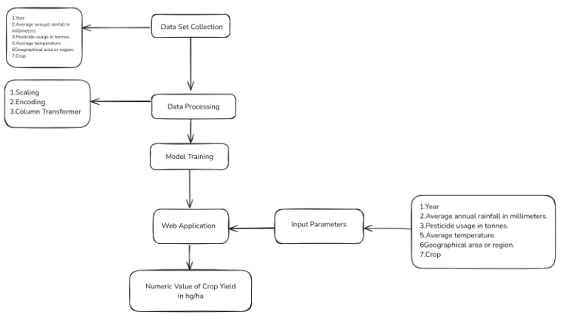
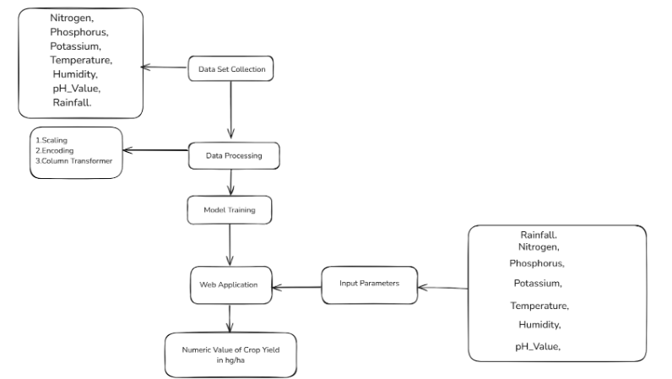
SYSTEM ARCHITECTURE
Yield
Prediction
Crop
Prediction

Slide 13



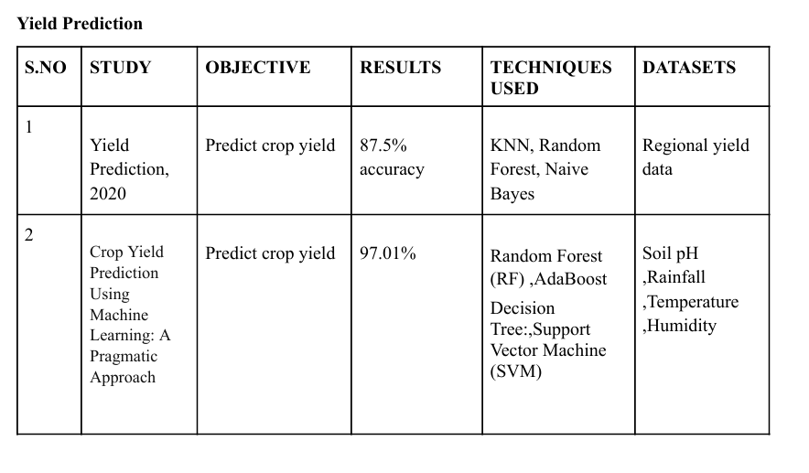

LITERATURE REVIEW

Slide 14
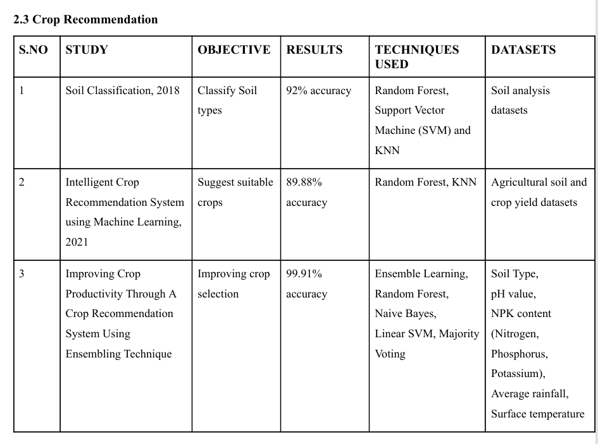
LITERATURE REVIEW

Slide 15
DRAWBACKS OF EXISTING SYSTEM
One shortcoming we identified in all these notable published works was that the authors of each paper focused on only one parameter (either weather or soil) for predicting the suitability of crop growth. However, in our opinion, both these factors should be taken together into consideration concomitantly for the most effective and most accurate prediction. This is often because a specific soil type could also be used for supporting one variety of crop, but if the climatic conditions of the regions don't seem to be suitable for that crop type, then the yield will suffer.

Slide 16
MODULE
DESCRIPTION
Crop Prediction Module:
Inputs: Soil and environmental factors such as nitrogen, phosphorus, potassium levels, temperature, humidity, pH value, and rainfall.
Process: Predicts the most suitable crop for cultivation based on these parameters using the Random Forest Classifier.
Outputs: Recommendations of crops like "Wheat" or "Rice".
Model Accuracy: Achieved 99.32%.
Yield Prediction Module:
Inputs: Factors like year, average rainfall, pesticide usage, average temperature, area, and type of crop.
Process: Forecasts the potential crop yield using the Decision Tree Regressor (DTR).
Outputs: Predicted crop yield (in hectograms per hectare).
Model Accuracy: Achieved 96.95%

Slide 17
WorkFlow
Crop Prediction

Slide 18
WorkFlow
Yield Prediction

Slide 19
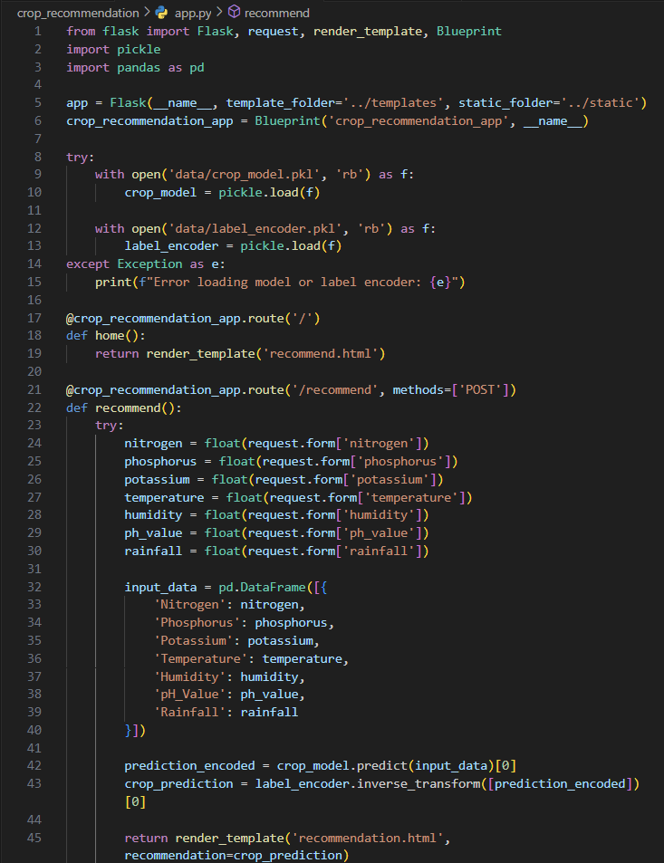

Code implementation:
crop_prediction/app.py

Slide 20
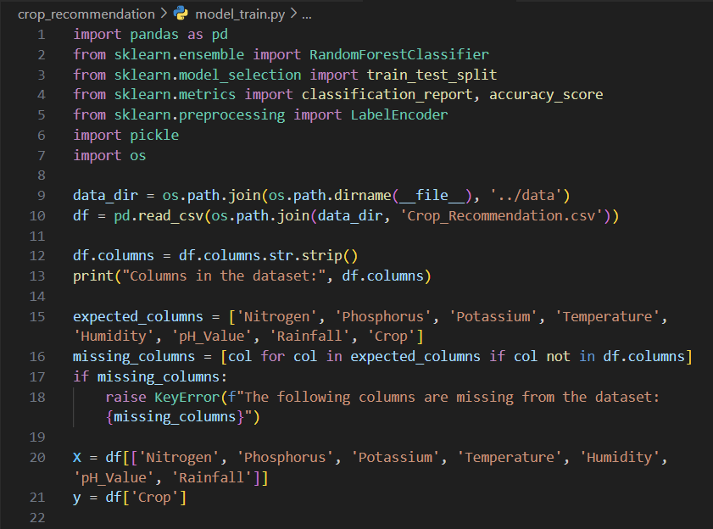
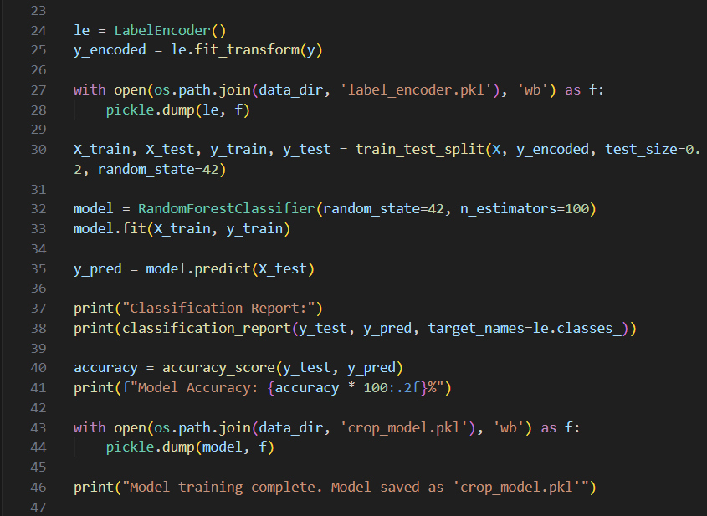
crop_prediction/model_train.py :-

Slide 21

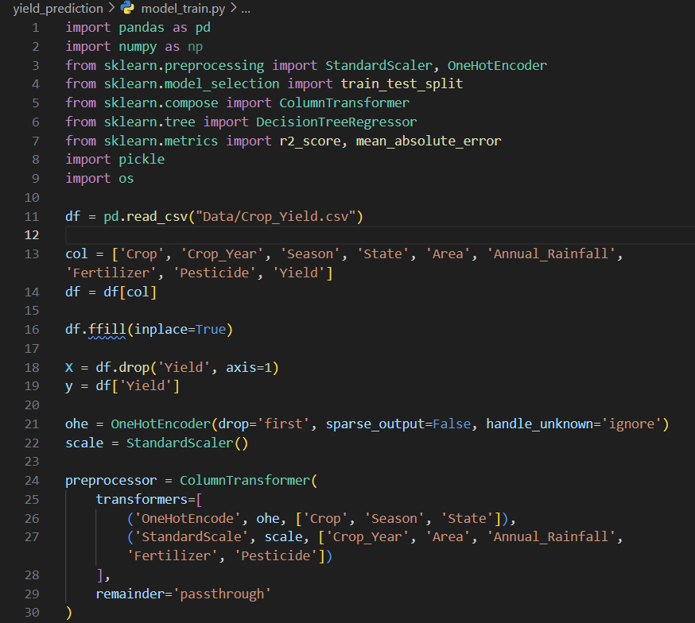
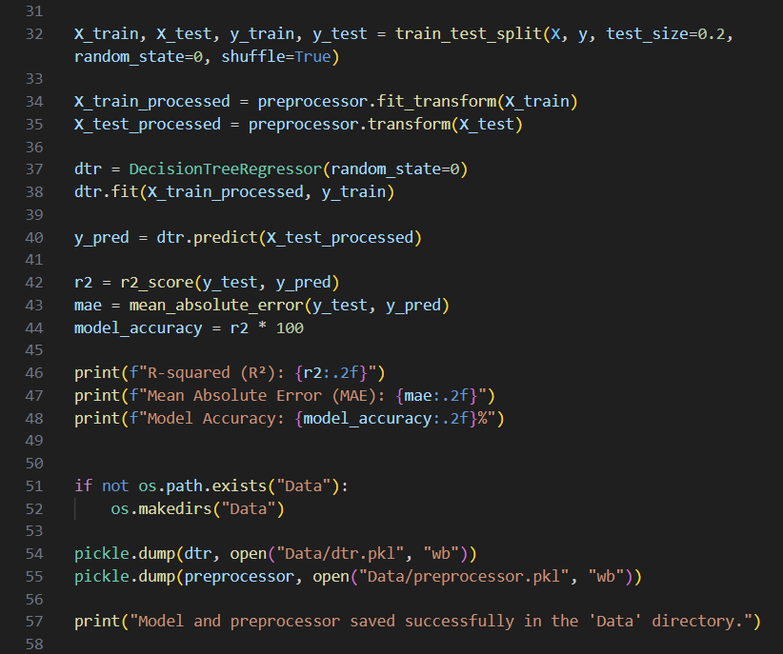

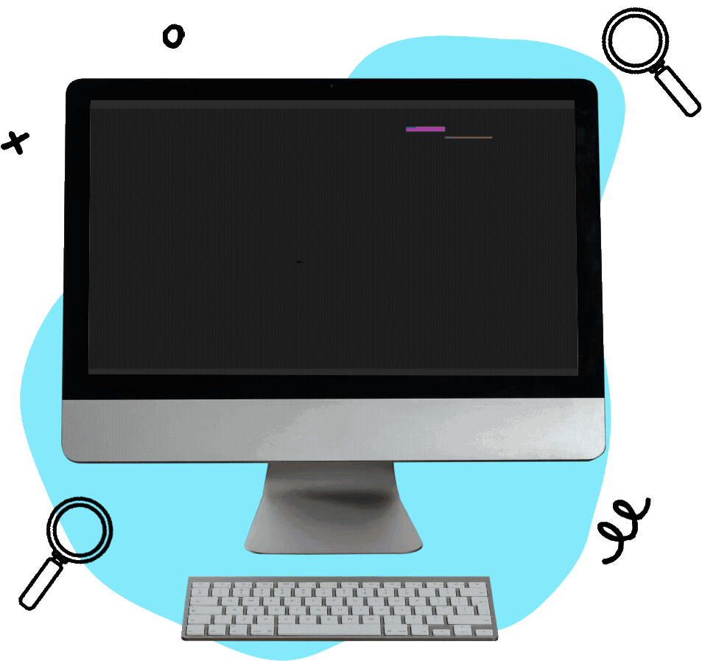
yield_prediction/model_train.py :-

Slide 22
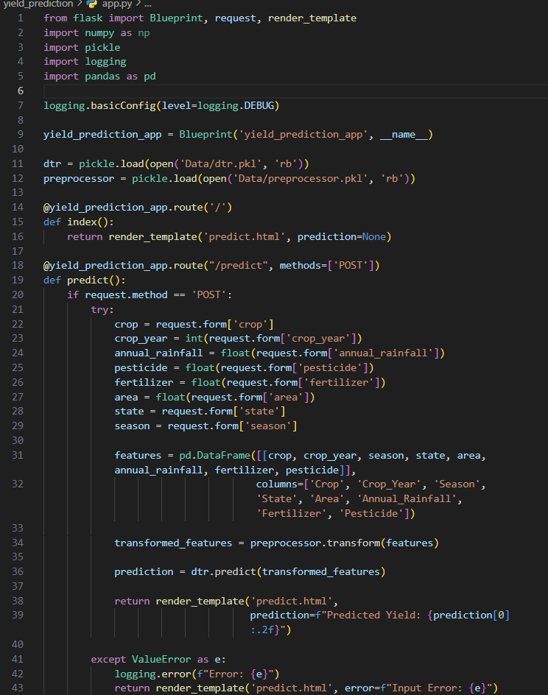

yield_prediction/app.py :-

Slide 23
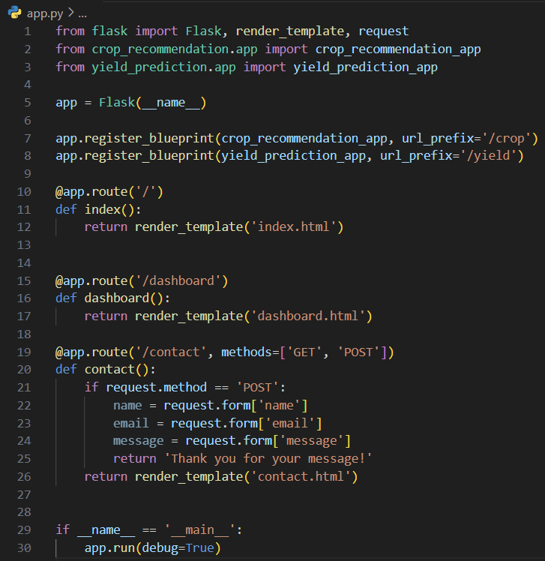
App.py-

Slide 24
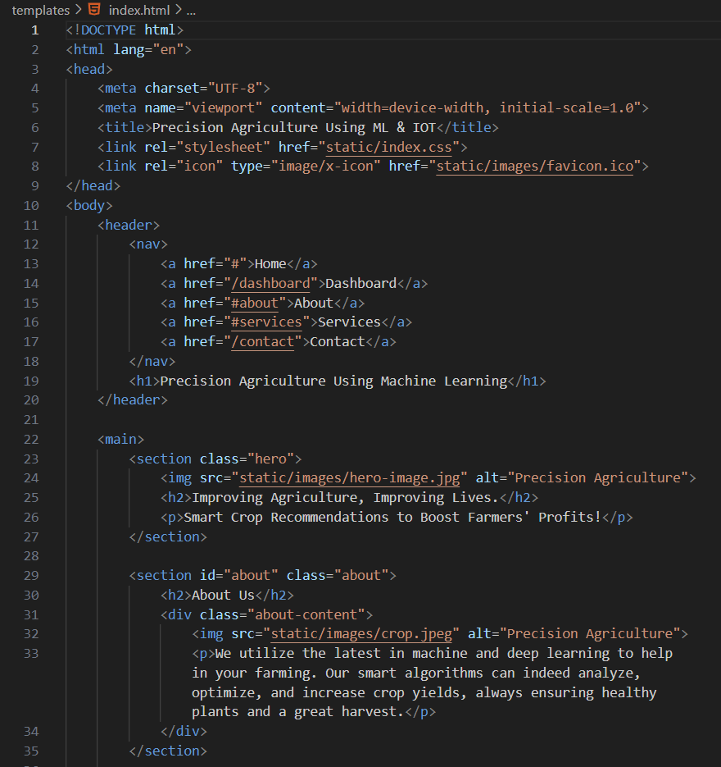
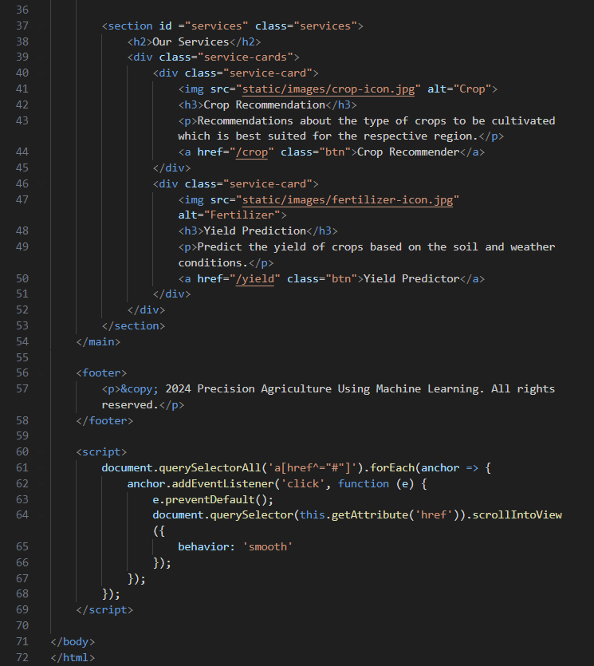
FRONTEND

Slide 25

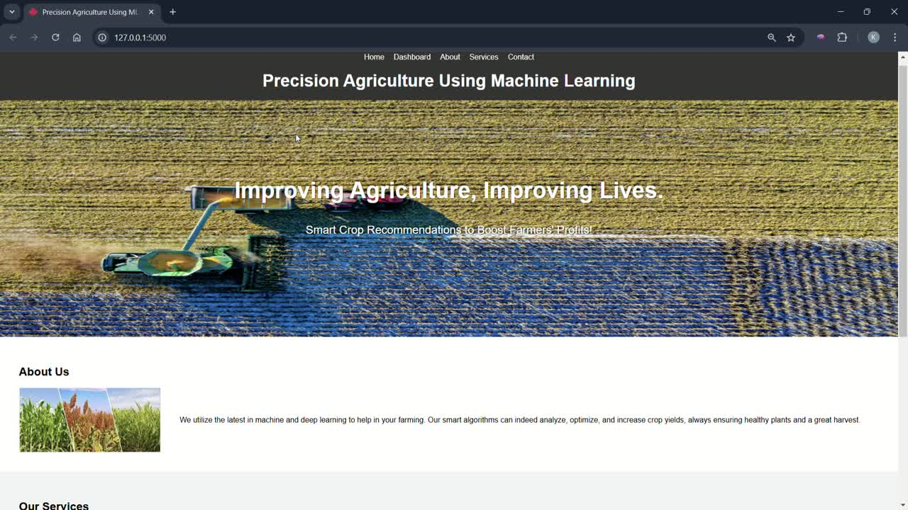
DEMO VIDEO

Slide 26
Testing
What we Tested ?
Accuracy: Evaluated how accurately the model can predict crop based on test conditions by comparing it with the actual crops provided in the dataset.
Performance: Enhancing its performance by testing again and again and training the model to achieve higher accuracy
How we tested?
Model Evaluation
After training, the model is tested on new data to assess its performance. The model's accuracy is measured by comparing its predicted crop yield to the actual values in the test dataset. Certain factors involve in model evaluation :-
Using metrics like precision, recall, and F1-score for classification tasks.
Using Mean Absolute Error (MAE) and R-squared (R²) for regression tasks.
Testing on Dataset:
The dataset is split into:
Training Set (80%): For training the model.
Testing Set (20%): For testing the model’s performance.

Slide 27
Conclusion
The crop recommendation system uses data and machine learning to help farmers choose crops based on soil, climate, and location, improving productivity and sustainability.
Key limitations include reliance on accurate data, challenges in adapting to different regions, and accessibility issues for small-scale farmers due to technology and language barriers.
Environmental changes require regular updates to ensure the system provides relevant and accurate recommendations.
Planned improvements include real-time updates via sensors and satellite data, support for local languages, pest management tools, and personalized irrigation and fertilizer planning.
With these enhancements, the system can empower farmers to grow better crops, reduce risks, and promote sustainable agriculture.

Slide 28
RESULT
INPUT
1.Crop Recommendation
OUTPUT
Nitrogen
Phosphorus
Potassium
Temperature
Humidity
pH Value
Rainfall
Crop Recommendation:
Type of Crop
Yield Prediction:
Amount of Yield(hg/ha)
2.Yield Prediction(hg/ha)
Year
Average Rainfall (mm/year)
Pesticides (tonnes)
Average Temperature (°C)
Area (The geographical region)
Item

Slide 29
Thank You

